Slide 1
NCL Start Well Programme
Harrow Health and Wellbeing Board
25 January 2024

Slide 2
Context and objectives
Today’s session is an opportunity to brief you on the proposals that have been developed as part of the Start Well Programme. This Programme of work was initiated in 2021 to ensure maternity, neonatal, children and young people’s services are set up to meet population needs and improve outcomes. The drivers for starting the work demonstrate that the programme is key to delivering against our duties around population health improvement and tackling inequalities.
This is a long programme of work, and no decision has been made on the changes. The ICB Board agreed at its meeting on Tuesday 5 December 2023 to initiate a 14-week consultation period, from 11 December 2023 until 17 March 2024. A decision on the proposals is not expected to be made until Autumn/Winter 2024/25.
The programme has developed a set of proposals to improve maternity and neonatal and children’s surgical services in NCL. The purpose of the briefing today is to:
  Provide some context on the programme, outline the rationale for change and how the options have been developed
  Describe the options being put forward for public consultation
  Outline the potential impact these proposals may have on different populations, including Harrow
  Capture your views and feedback on the approach to consultation and how best to engage with the populations in Harrow who may be potentially impacted
The link to the consultation website where you can find more information and details about the programme is: nclhealthandcare.org.uk/start-well

Slide 3
Background and context

Slide 4
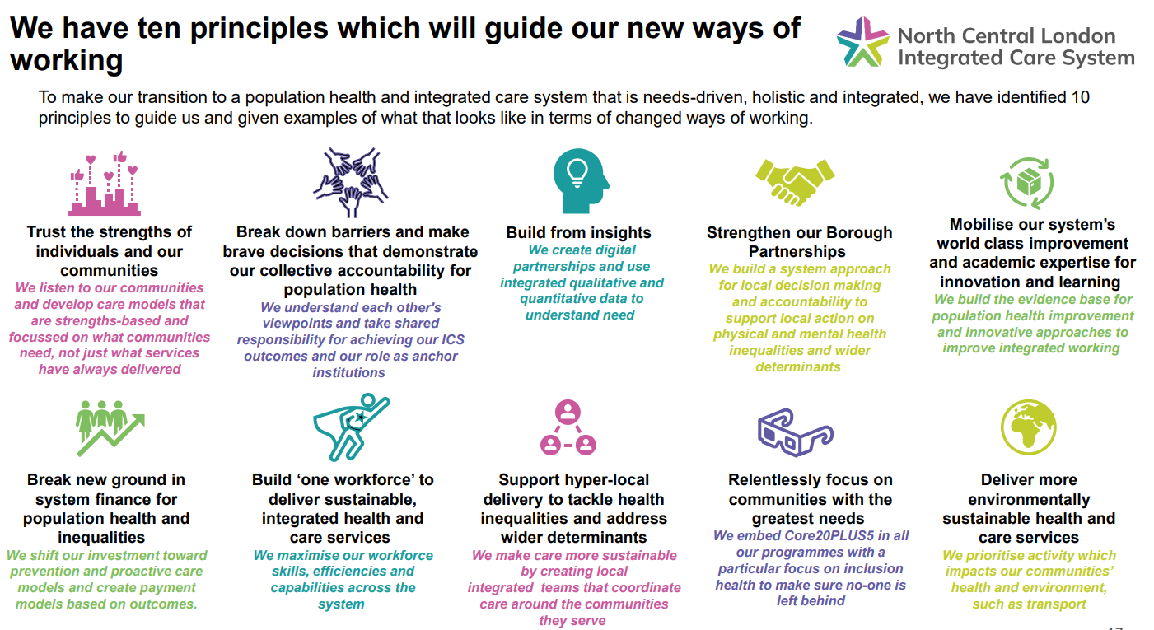
The drivers for this programme and the need for change are rooted in our relentless focus on improving outcomes and reducing inequalities within our population
North Central London ICS has an ambition to provide services that support the best start in life, both for our residents and for people from neighbouring boroughs and beyond who choose to use our services.
We know that care received at the beginning of life is a powerful force against health inequalities and a catalyst for improved life chances which is why Start Well is a key priority in our Population Health and Integrated Care Strategy.
Central to the Start Well programme are the needs of pregnant women and people and their babies. We want to ensure our services are in the best position to support families through the life changing journey of pregnancy and birth.
Source: North Central London ICS Population Health and Integrated Care Strategy
https://nclhealthandcare.org.uk/our-working-areas/population-health/

Slide 5


The Start Well programme will support us to tackle inequalities and improve population health outcomes
The Start Well programme was initiated to ensure services are set up to meet population needs and improve outcomes. The drivers for starting the work demonstrate that the programme is key to delivering against our duties around population health improvement and tackling inequalities
Improving care at the start of life has the potential to have far reaching impacts on overall population health and life outcomes
There is longstanding inequity in service provision across maternity, neonatal and paediatric services – with not everyone having access to the same care as others
The quality of services could be improved, and some service users face differential outcomes and experience
Our workforce is constrained and, in some instances, our people are working in environments that are not set up for them to provide the best possible patient care
Ensuring we are in a position to respond to national reviews and best practice guidance such as the Three Year Delivery Plan for Maternity and Neonatal Care
The ICS also has a number of other programmes which are aiming to achieve population health improvements and integration of care such as a review into community services, mental health services and the implementation of a Long Term Conditions Locally Commissioned Service for Primary Care.

Slide 6









Start Well is a collaborative programme involving a wide range of patients, carers, community representatives, clinical leaders and ICS partners
Options appraisal
Finance assurance
August 23 – September 23
Assurance of capital assumptions for each option through 1:1 assurance meetings with CFOs
Further assurance of wider finance case through CFO group, and sign off in September
November 22 – May 23
Evaluation of options was undertaken through 10 clinical reference group meetings, 8 finance group meetings and 3 patient and public engagement group meetings
Start of review
New care models
November 21
Agreement across all organisations to commence the programme following Trust Board engagement.
July – September 21
Future facing best practice care models were developed. This involved over 100 clinicians through workshops and task and finish groups
Options appraisal workshop
NHSE Assurance
November 23
Assurance of proposals by NHSE, a requirement in advance of commencing a consultation. Trust Board sign up to proposals is needed for this
May 23
Programme board workshop where options were narrowed involving local authority partners, Trust reps as well as NEL, NWL and Herts.
Clinical senate review
Case for change development
July 23
A panel of over 30 senate panel members reviewed and feedback on proposals. Lead clinicians from NCL represented the programme
November 21 – May 22
The clinical case for change was co-developed through significant clinical engagement, including: 60 interviews, 12 reference group meetings, 2 large clinical workshops and 5 surgical deep dive sessions
Case for change engagement
July – September 22
Engagement with patients and the public on the case for change, including:
  207 in depth discussions
  389 questionnaire responses
  16 stakeholder meetings
  2 youth summits
Over 75% of respondents agreed or strongly agreed with opportunities identified
ICB Board
Public consultation
IIA engagement
December 5th 23
Seeking approval to commence consultation on proposals
Pre-consultation business case development
May – June 23
Engagement with over 120 service users about their experiences of maternity and neonatal care to build up an understanding of the impact of implementing changes
December 23 – March 24
Seeking feedback on proposals which will inform subsequent decision making
May 23 – September 23
Drafting of pre-consultation cases that outline proposals and new clinical model to be implemented
The programme, which began in November 2021, has benefited from extensive clinical and service user input.

Slide 7
Maternity and neonatal services proposals

Slide 8
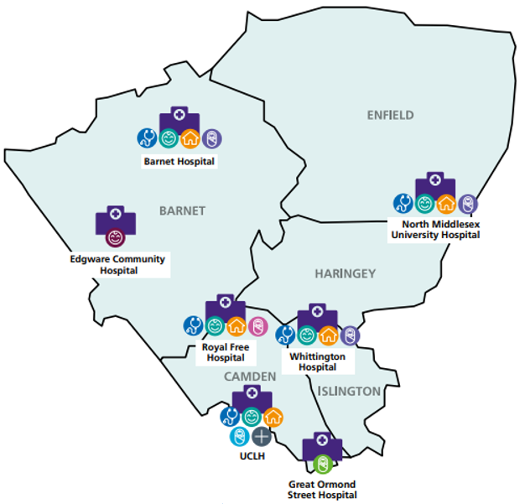
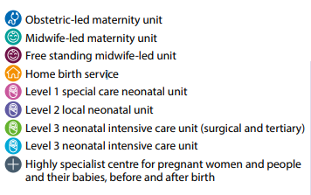
How maternity and neonatal care is currently organised in North Central London
In our five boroughs we have five maternity and neonatal units and a standalone midwifery led birth centre:
Five obstetric units
Five alongside midwifery-led units
One standalone midwifery-led unit at Edgware Community Hospital
One special care neonatal unit (level 1)
Two local neonatal units (level 2)
Two NICUs (level 3 – one of which is at GOSH and out of scope of the proposals)
Pregnant women and people can access maternity care at their unit of choice. This means people who live within Barnet, Camden, Haringey, Enfield or Islington may choose a hospital outside of these area and those who live outside the NCL boroughs can access maternity care at a hospital within NCL

Slide 9





There are important clinical drivers for change in our maternity and neonatal services
NCL has a declining birth rate, with increasing complexity of service users. There is insufficient activity and staff to sustain five maternity and neonatal units in the long term
Staffing levels do not always meet best practice guidance and there are high vacancy rates which frequently compromise service provision. This often leads to the inability to staff birth centres – meaning the choice of midwifery-led care is often compromised
The level 1 unit at the Royal Free Hospital was only 37% occupied in 2021/22. The number of admissions to the unit have been falling and there are expensive and complex mitigations in place to maintain its safety. This unit does not provide equitable care to service users and it represents a clinical risk, which requires a long-term solution as identified by the London Neonatal Operational Delivery Network and the Trust
The maternity and neonatal estate at the Whittington Hospital does not meet with modern best practice building standards. It has no ensuite bathrooms in its labour ward, its neonatal unit is cramped with risks around infection control. These risks are actively mitigated by excellent staff and clinical processes; however, this does create increased pressure on staff to safely deliver the service
Maternity CQC re-inspections has identified challenges with maternity services in NCL and there are opportunities to improve their quality
Edgware Birth Centre supports an ever-decreasing number of women to give birth – in 22/23 only 34 women gave birth there. Given the declining birth rate and increasing complexity of births it is unlikely this will increase in the future

Slide 10





Our vision for maternity and neonatal care is delivered through our new care model
Our vision for maternity and neonatal services
The new care model proposes:
Bringing together maternity and neonatal care into four units as opposed to our current five
Three level 2 neonatal units as well as the specialist NICU at UCLH
No longer having a level 1 neonatal unit
No longer having a standalone midwifery-led birth centre
Provision of high-quality equitable care: all units being able to provide the same level of neonatal care will address the current inequity of having a level 1 neonatal unit as local provision for those closest to that level 1 unit is less comprehensive than the local provision for those closer to any of the level 2 centres
Units that provide sustainable activity numbers: through consolidation, we will have larger units which are more clinically sustainable in the long term given the declining NCL birth rate and the need to make best use of our scarce workforce
Workforce resilience: units staffed in line with best practice, supporting our teams to deliver high quality care. Delivering this over four units as opposed to five means increased workforce resilience and units will be less vulnerable to short term closures – ensuring that choice of birth setting can be facilitated in a more consistent way. This may also help deliver greater continuity of care to parents, which is currently a challenge to deliver as our workforce are spread thinly
The right capacity to meet demand: ensuring that NCL has access to the right level of capacity to meet changing needs of our population – including access to specialist care where it may be needed
Environment that provides a positive patient experience: investing in our estate and making improvements that will address current issues. We will invest in making sure we have optimally sized units, meaning better value for money and wider benefits of adopting the new care model

Slide 11
Our preferred option
Options for consultation – maternity and neonates
Option A: UCLH, North Mid, Barnet, Whittington
Option B: UCLH, North Mid, Barnet, Royal Free
UCLH
Consultant-led obstetric unit with co-located NICU (level 3) neonatal intensive care unit, alongside midwife-led unit and a home birth service
UCLH
Consultant-led obstetric unit with co-located NICU (level 3) neonatal intensive care unit, alongside midwife-led unit and a home birth service
North Mid
Consultant-led obstetric unit with co-located LNU (level 2), alongside midwife-led unit and a home birth service
North Mid
Consultant-led obstetric unit with co-located LNU (level 2), alongside midwife-led unit and a home birth service
Barnet
Consultant-led obstetric unit with co-located LNU (level 2), alongside midwife-led unit and a home birth service
Barnet
Consultant-led obstetric unit with co-located LNU (level 2), alongside midwife-led unit and a home birth service
Whittington Hospital
Consultant-led obstetric unit with co-located LNU (level 2), alongside midwife-led unit and a home birth service
Royal Free Hospital
Consultant-led obstetric unit with co-located LNU (level 2), alongside midwife-led unit and a home birth service
Royal Free Hospital
Maternity and neonatal services would cease to be provided
Whittington Hospital
Maternity and neonatal services would cease to be provided
Closure of the birthing suites at Edgware Birth Centre

Slide 12
Both options being put forward for consultation are deemed to be implementable
Both proposed options being put forward for consultation have been deemed to be implementable and we are consulting on both options.
Option A has been identified as the preferred option for consultation because:
it would mean fewer staff needing to move to a new location
option B would mean some people would need to go to hospitals in North East London that would struggle to have capacity for this because of rising birth rates in some parts of North East London
while option A would mean some people would need to go to hospitals in North West London, those hospitals have confirmed they have capacity for this as the number of births in North West London is falling
The status quo is not an option for consultation because:
The way services are currently set up won’t meet the long-term needs of our population and doesn’t resolve the challenges identified in our case for change
Staffing services across five sites as opposed to four would continue to be a challenge and not make best use of our skilled workforce
The neonatal unit at the Royal Free Hospital would continue to need support to maintain the skills of staff and this does not represent a long term, sustainable solution

Slide 13
Future flows have been projected for each option, using an approach which considers choice
Note: LSOA is a Lower Super Output Area and is the smallest granularity of geography that is used for travel time analysis. Typically, there are 1,000-2,000 residents within an LSOA.
Approach
Description
1
For each LSOA identify the closest hospital for the catchment population
The catchment population for the patient flow analysis has been defined as all LSOAs in NCL where there was activity in the 2021/22 baseline year and any LSOAs for whom an NCL site is the closest hospital, this includes any populations living in neighbouring boroughs.
The neighbouring ICSs have been defined as all London ICSs plus Hertfordshire and West Essex ICS
The closest hospital is found using the Travel Time API (Google), calculating the travel time in minutes at peak time
2
Calculate the number of deliveries at each in scope hospital in 21/22 by LSOA
The volume of activity at each of the in-scope hospitals has been calculated for each of the LSOAs in the catchment population
The hospitals that are in scope of this work are all acute NCL hospitals and the following neighbouring units: St Mary’s, Chelsea and Westminster, Northwick Park, Homerton, Whipps Cross, Royal London, Princess Alexandra, Watford General, Newham, Luton and Lister Hospitals
3
Understand in each LSOA the number of people giving birth at their closest unit or choosing to give birth elsewhere
It is modelled that everyone in an LSOA flows to their nearest unit by travel time (car/driving at peak times). If this unit is modelled as closed, then the population will be modelled as flowing to the next nearest.
However, if over 80% of people in any LSOA are currently choosing to go to a unit further away than their nearest by travel time, then everyone in that LSOA is modelled to travel further to the unit of choice.
In each option, when a unit closes, everyone who was modelled to go to that unit is then modelled to go to their nearest hospital instead

Slide 14



We identified the people who may be impacted by the proposals
We looked at where people currently live and identified geographies whose closest hospital is Royal Free (option A) or Whittington (option B)
For the impacted populations we looked at what the next closest hospital would be and projected the activity to the next nearest unit. All activity in that LSOA is flowed to this hospital.
This modelling is based on historic activity and a set of assumptions and therefore is indicative. Whilst the modelling approach has factored in choice there may be individuals within the impacted LSOAs who choose a hospital that is further away than the closest.
Currently: where people go now (the closest)
Future: Predicted flow if maternity unit at Site A closed
Site A
(Closest)
Site A
(CLOSED)
Site B
(Next closest)
Notes:
ADD IN BIT ABOUT NCL:
PEOPLE WILL GET CONFUSED OTHERWISE: make sure that there’s an idea.
Make it quite clear about patient flow: but make sure make a page about it.
Somewhere: need to

Slide 15
Option A
The proposals in option A would result in 2,560 deliveries being being moved to another unit
Based on future activity modelling, in option A, 2,560 deliveries are would be moved from the Royal Free Hospital to another unit. This includes units that may be outside of NCL.
Of the 2,560, 73% (1,860) are NCL residents and the remaining 27% (700) are non-NCL residents.
Of the non-NCL residents impacted 558 are NWL residents
Of the NWL residents impacted:
    Brent: 380
    Ealing: 18
    Harrow: 124
    Hillingdon: 8
    Hounslow: 1
    Westminster: 27
  The proportion of total deliveries impacted by NWL borough is set out in the graph to the right
Proportion of activity which may being impacted by borough

Slide 16
Option A
In option A, the majority of impacted residents in Harrow are projected to flow to Barnet Hospital
Based on future activity modelling, in option A, 2,560 deliveries would be moved from the Royal Free Hospital to another unit. This includes units that may be outside of NCL.
Of the 2,560, 73% (1,860) are NCL residents and the remaining 27% (700) are non-NCL residents.
Of the non-NCL residents impacted 558 are NWL residents
Of the NWL residents impacted 124 are Harrow residents
Based on the modelling the impacted residents have been modelled to flow to the next nearest hospital by driving at peak times as follows:
  Barnet: 90
  Northwick park: 26
  Watford General Hospital: 8
Option A: Projected deliveries by site for all impacted Harrow residents

Slide 17
Option B
The proposals in option B would result in 3,391 deliveries being being moved to another unit
Based on future activity modelling, in option B, 3,391 deliveries would be moved from the Whittington Hospital to another unit. This includes units that may be outside of NCL.
Of the 3,391, 88% (2,978) are NCL residents and the remaining 11% (413) are non-NCL residents.
Of the non-NCL residents impacted 39 are NWL residents
Of the NWL residents impacted:
    Brent: 27
    Ealing: 2
    Hammersmith and Fulham: 1
    Harrow: 1
    Hillingdon: 2
    Westminster: 6
  The proportion of total deliveries impacted by borough is set out in the graph to the right
Proportion of activity which may being impacted by borough

Slide 18
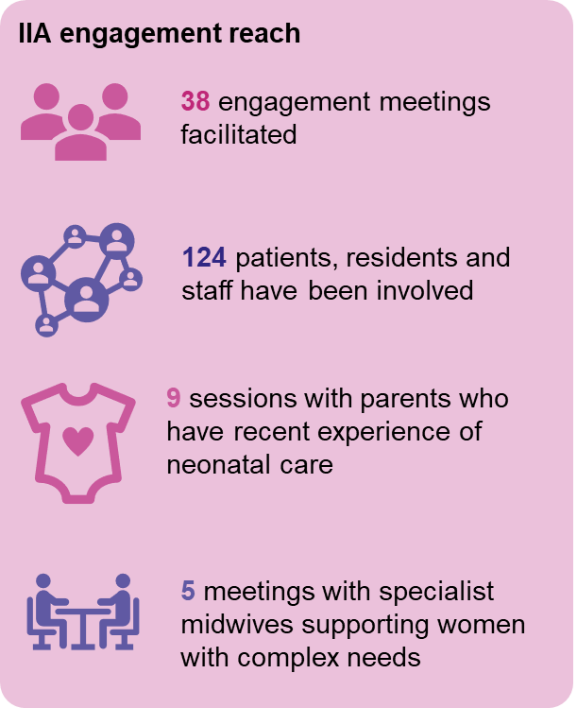
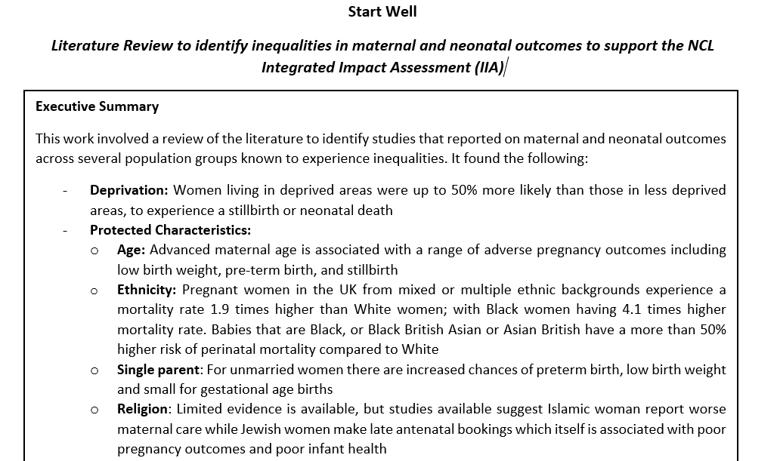
We have built up an understanding of the impact of our proposals through our Interim Integrated Impact Assessment
Our IIA draws on multiple strands of work which has supported us to build a picture of what the impact of our proposals could be, and who may be impacted:
Our case for change took a population health approach and identified service users with characteristics who may be at risk of health inequalities
We undertook a supplementary literature Review to identify inequalities in maternal and neonatal outcomes undertaken by public health professionals
We engaged with potentially impacted groups to understand their views on the possible impact of proposals
We have undertaken extensive analysis on:
  Accessibility (travel time, cost, parking, public transport access, car ownership)
  Population demographics
  Sustainability impact by looking at carbon emissions
We have identified the following impacts of our proposals:
Accessibility: relatively small average increases in travel time across both options (both by public transport and car)
Cost of travel: additional expenses when travelling by taxi on average of £4, but close to the closing sites up to £11
Accessing an unfamiliar hospital site: changes may mean people having to travel to and navigate around a hospital site which they are unfamiliar with
Understanding changes: service users need to be able to understand their choices of maternity care and what change could mean for them

Slide 19
Two specific geographical areas were identified as being more vulnerable to the impact of our proposals
Two geographical areas were identified as having residents who may be more vulnerable to the impact of our proposals because they face barriers to accessing services due to living in areas of deprivation and having high levels of poor general health
As a result of the proposals, people in Harlesden and Willesden (option A), and Holloway and Finsbury Park (option B) may need additional support to:
  Access the hospital site if they are disabled/in poor health or are not proficient in English
  Travel to hospital by taxi, if required, as it will cost an additional £4-£5 per journey
  Access services online as they may have lower digital proficiency
  Care for other family members as they may be a lone parent
Black African and Black Caribbean populations are concentrated in these geographies and have poorer maternity outcomes
Harlesden has a large proportion of Bangladeshi and Pakistani populations, who are more likely to have worse maternal health outcomes
Weightings were used to ranks all LSOAs from highest to lowest against a range of metrics including ethnic minorities, deprivation and poor health outcomes where 1 = worst, 400 = best. A weighted average was then developed for each LSOA and used to identify populations who may be more vulnerable to the impact of our proposals
Notes:
Put in exec summary

Slide 20
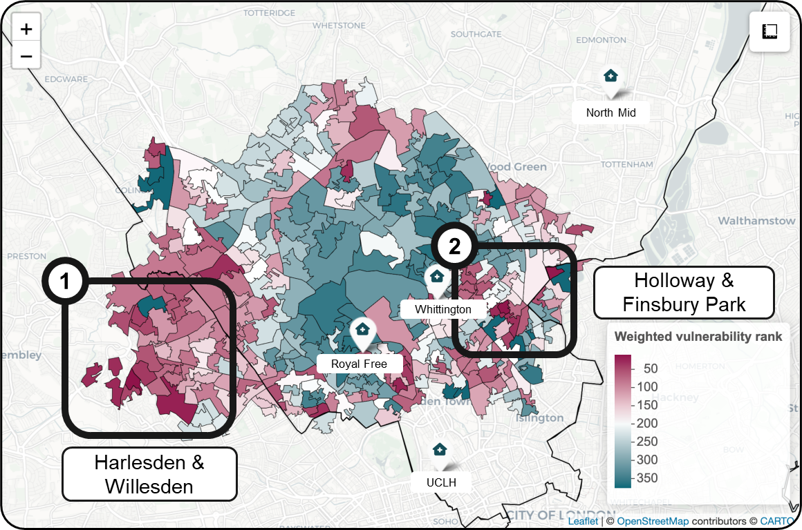
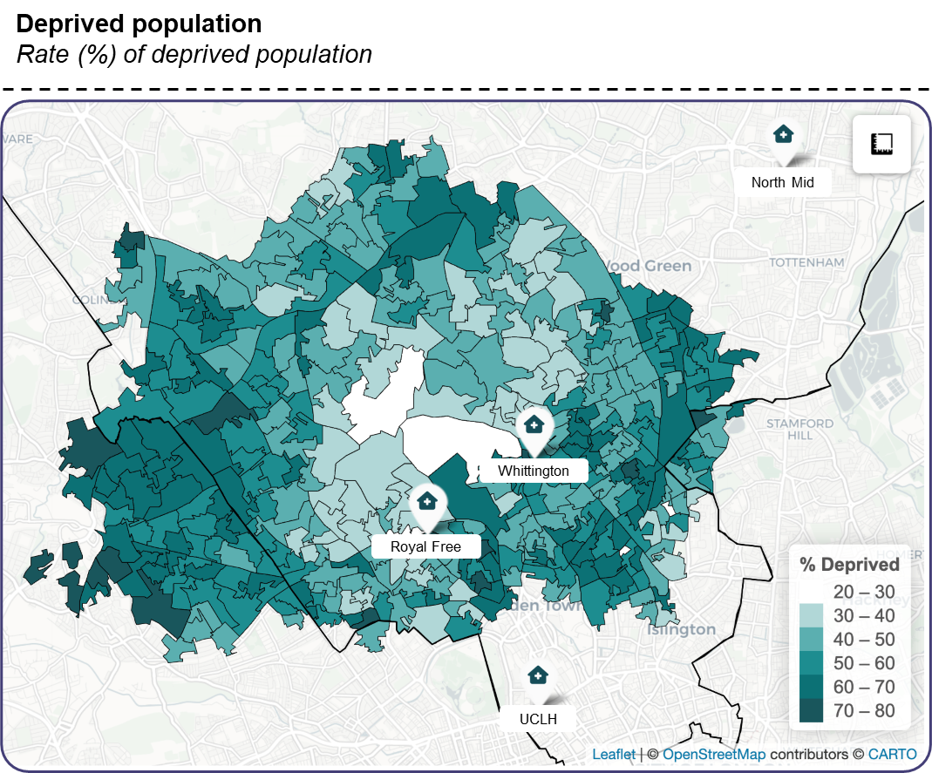
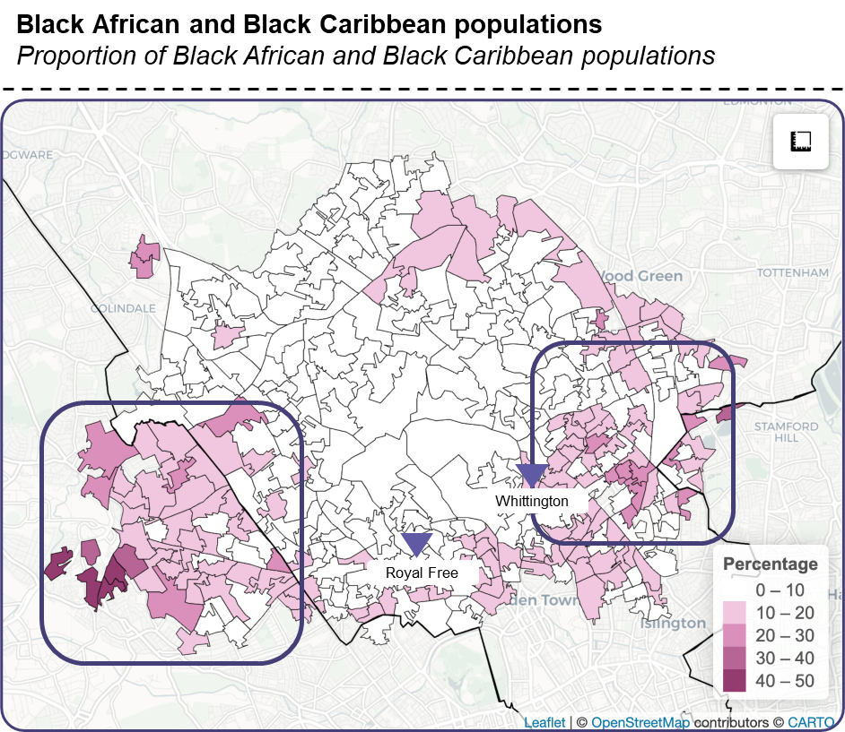
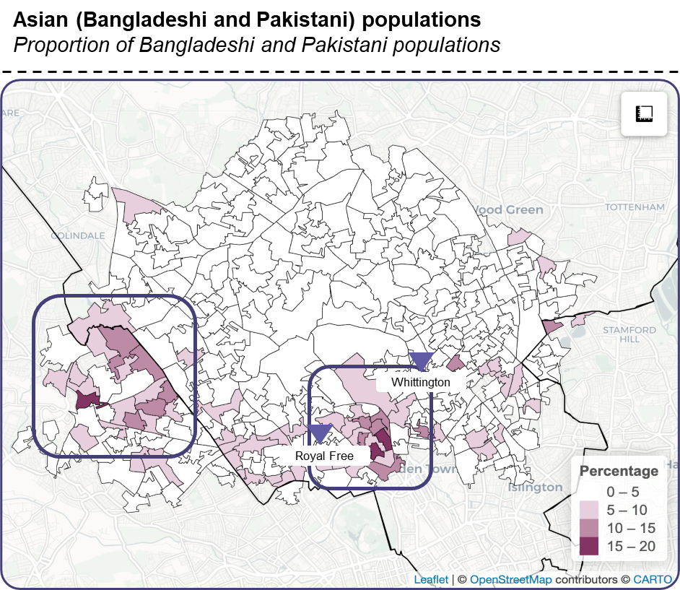
There are a range of population groups who may be impacted if we were to implement either option A or B
People living in geographic areas who may have vulnerabilities: we identified two neighbouring areas with a higher concentration of people who may be vulnerable to service changes. Harlesden and Willesden would be more impacted by option A and Holloway and Finsbury Park would be more impacted by option B. The reason that these areas have been identified is due to their higher concentration of people who belong to an ethnic minority, people with poorer English proficiency and areas of higher deprivation. Mitigations for these populations include a focus on continuity of care and ensuring there is integration with other local services
Women and people who live in deprived areas: there is a link between people living in deprivation and adverse outcomes from maternity and neonatal care. People living in these areas may be particularly impacted by increased taxi costs if either option A or B were to be implemented.
Black African (including Somali) and Black Caribbean women and people of childbearing age: there is evidence that Black African and Black Caribbean women and people may experience poorer maternity outcomes. The impact on Black African and Black Caribbean women of proposed changes may be around navigating to a potentially unfamiliar hospital site, language, additional transport costs and consideration of their wider health needs during pregnancy.
Asian women and people of childbearing age: there is evidence that Asian (particularly Bangladeshi and Pakistani) women and people may experience worse outcomes from maternity care. The impact for them may be around navigating to a potentially unfamiliar hospital site, language, additional transport costs and consideration of wider health needs given evidence of higher prevalence of conditions such as diabetes.
Notes:
Split across two or think how to display

Slide 21
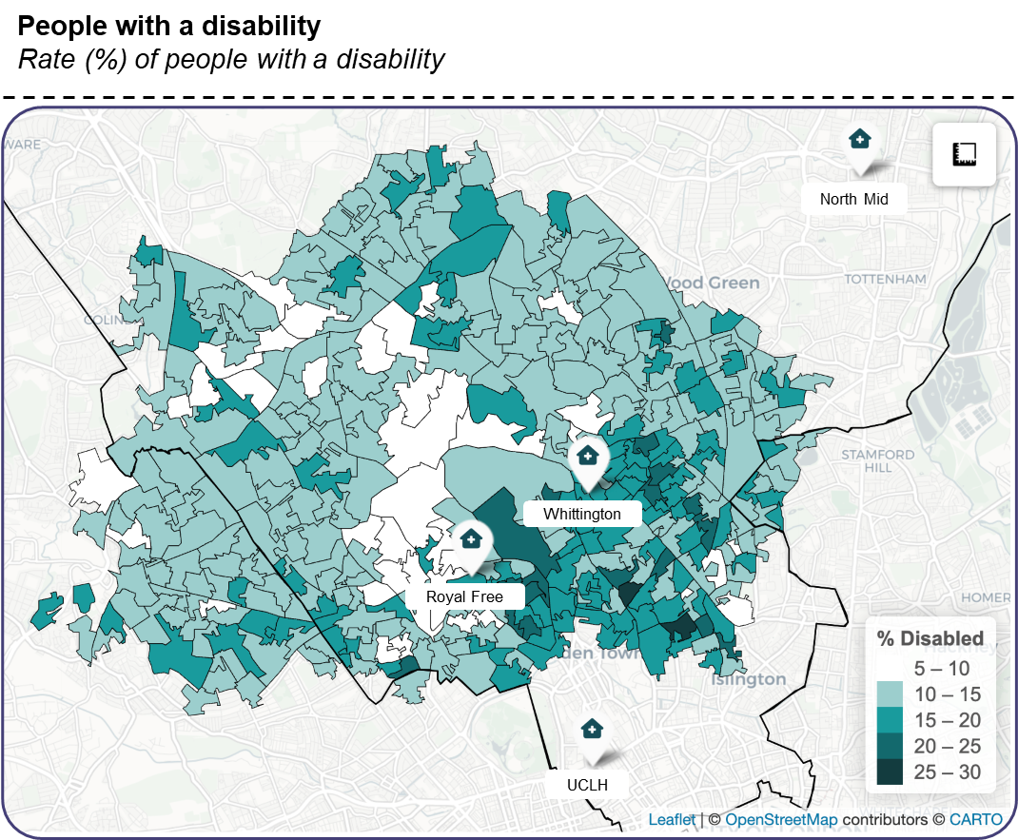
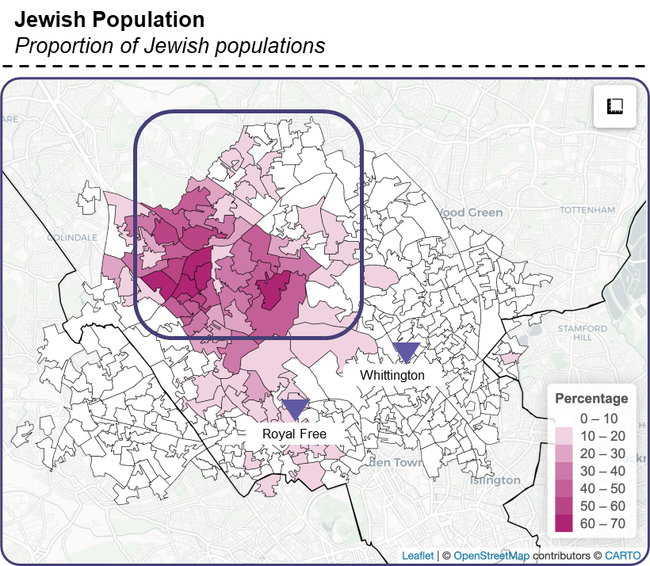
There are a range of population groups who may be impacted if we were to implement either option A or B
Through engagement with service users to date, we have developed mitigations that may need to be put in place to support service users with a range of different needs should a decision be taken to implement proposals. This covers areas such as:
Communication and information sharing
Travel and transport
Ongoing engagement with communities
Women and people of childbearing age with disabilities (including learning disabilities): people with disabilities may be more impacted by proposed changes due to challenges navigating to an unfamiliar hospital site, taxi costs due to lower car ownership and the physical accessibility of hospital sites.
Women and people from the orthodox Jewish community: Orthodox Jewish people may be impacted by the proposed changes, particularly around Option A. Consideration may need to be given for the specific needs of this group around maternity care. This includes requirements around Kosher food, observance of Shabbat and the impact on travel and ability to access online or digital materials.
There are a number of other service users who have characteristics that make them potentially more impacted should we implement option A or B which our IIA identifies. This includes older and younger pregnant women and people, people with poor literacy and women and people in inclusion health groups.
We would seek as a priority to engage with all of these groups during the consultation period.
Notes:
Split across two or think how to display

Slide 22
The birthing suites at Edgware Birth Centre

Slide 23
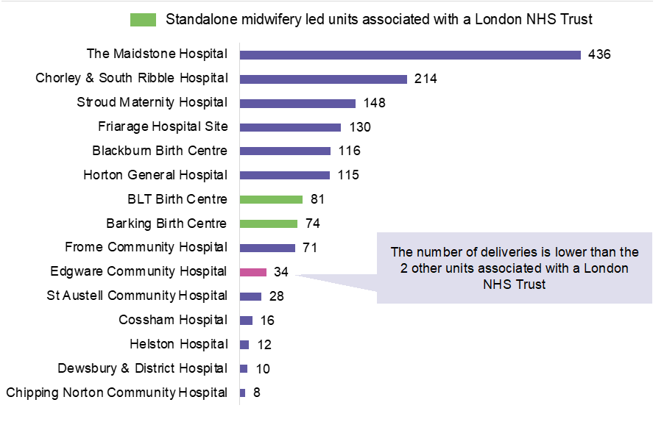
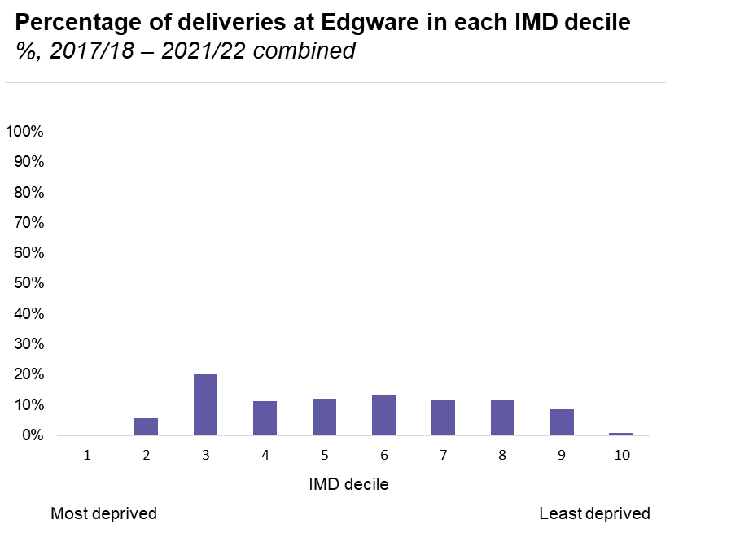
We are also proposing closing the birthing suites at Edgware Birth Centre
Case for change for Edgware Birth Centre
Edgware Birth Centre does not provide the right type of capacity for our population, with analysis suggesting only 30% of women across NCL would be clinically appropriate to give birth there and an even smaller number of this 30% would be within close travelling distance of the unit
Births are becoming more complex and anticipated to decline over the next 10 years, meaning it would be very difficult to increase activity numbers at the unit
The number of births at the unit has been declining every year since 2017 and it is one of units with the smallest number of births in the country, with only 34 births in the last financial year
We do not have the workforce to support the unit as well as our other alongside midwifery-led units which leads to short term closures of the service
There are opportunities to use the space at the site in a more efficient way and provide antenatal and post natal services for our local population there that are more in line with their needs
We are consulting on this as a separate proposal alongside the maternity and neonatal proposals. They are not dependent on one another.

Slide 24
Surgery for babies and children

Slide 25





There are several important clinical drivers for change in our paediatric surgical services
There is currently a lack of defined emergency surgical pathways for young children meaning that clinicians in emergency departments make multiple enquires to secure the right pathway for individual children.
Some children are transferred up to three times before receiving emergency surgical treatment in the right setting. From April 2020 to March 2021, 144 children and young people were transferred from an NCL provider to other hospitals for an emergency surgical procedure
Access to surgical and anaesthetic workforce to deliver care for young children is limited at local sites and scarce nationally, with the ability to undertake an operation often dependent on the skills of the individual staff on duty that day
There are some operations being undertaken in very low volumes at local sites which raises questions about the ability of staff to maintain their skills
There is lack of clarity on the role of Great Ormond Street Hospital in caring for local NCL children and young people requiring surgery, alongside its tertiary and quaternary work
Children are not always looked after in age-appropriate environments, or on child-only lists which does not represent a high-quality patient experience
There are long waits for planned operations, particularly in ENT and Dentistry, and there are opportunities to consider how these high-volume specialties better manage demand and capacity
There were broader opportunities to improve identified through the case for change which are being addressed through other programmes of work.

Slide 26




Our proposals will improve quality outcomes and patient experience for paediatric surgical care
Paediatric surgery care model benefits
Access
Paediatric surgical care will be delivered in the appropriate setting to ensure that all patients receive the care they require as quickly as possible
Environment
Ensure all children receive care in a child friendly environment where possible, on dedicated children’s surgical lists
Sustainable services
Consolidating low volume specialties and ensuring staff maintain competencies will ensure that surgical services remain sustainable
Workforce
Make best use of paediatric surgeons and consultant paediatric anaesthetists to deliver planned and emergency surgical care to children at a fewer number of sites
Surgical pathways
Providing clarity on surgical pathways reduces time taken to find a bed at local units or transfer children

Slide 27
Option for consultation – paediatric surgery
We developed and appraised options for the location of planned and emergency surgical services for children and young people in NCL
Following our options appraisal, there is one option for consultation for the location of the ‘Centre of expertise: day case’ and ‘Centre of expertise: emergency and planned inpatient’
Option for consultation
Centre of Expertise: emergency & planned inpatient
Centre of Expertise: day case
GOSH
Would deliver majority of surgical care for children under 3 years and under 5 years (general surgery and urology). Would provide planned inpatient surgery for children age 1 years and over for low volume specialties.
UCLH
Would delivers all day case surgery for children age 1 and 2 years. Would provide day case activity for all children age 3 years and over for low volume specialties.

Slide 28
The proposed care model would move less than 10% of paediatric surgical care in NCL
Centre of Expertise: Daycase – c.300 children
Bringing together planned daycase activity
Out of area
Emergency paediatric surgical activity that would continue to be delivered outside NCL (e.g., major trauma)
Centre of Expertise: Emergency & planned inpatient – c. 300 children for surgical care and c.1,000 children for surgical assessment
Bringing together emergency for very young children and planned inpatient care
Local and specialist units
Most of the emergency and planned activity would remain at local units or at specialist units. This means that children and young people are seen at the place best suited to their needs.

Slide 29
The consultation

Slide 30
The programme has benefited from substantial input from service users and local communities and public consultation will expand the reach of the engagement to date
Case for change development
Review of existing patient experience insights data from 11 different sources
Establishment of a youth mentoring scheme and youth summits
Targeted engagement with a small number of patient groups
Care model development
Establishment of the Patient and Public Engagement Group (PPEG) to review and input into care models
Feedback from case for change engagement informed their development
Two youth summits involving 35 young people
IIA Engagement
11-week targeted engagement period focussing on those with protected characteristics and at risk of poorer outcomes
38 sessions held, reaching 124 patients
Case for change engagement
A 10-week engagement programme
43 engagement events
207 in-depth conversations
389 questionnaires completed
Options appraisal
PPEG responsible for development and initial evaluation of access criteria
PPEG Chair a member of the programme board and participated in the programme board workshop for the options appraisal
Public Consultation
Widely promoted high volume engagement with all staff, stakeholders and residents
Some in-depth conversations with targeted groups
A formal part of our statutory duties around major service change and ongoing involvement of people and communities

Slide 31
14-week public consultation from mid-December 2023
Approval given to commence a 14-week consultation to gather views from service users, stakeholders, residents and staff, running from 11 December – 17 March 2024.
Development of the consultation plan
Key Legal Duties
This consultation will fulfil our duty under the
NHS Act 2006 (as amended by the Health and Social Care Act 2012 and the Health and Care Act 2022)
  to ensure that people who use NHS services are involved in the development and consideration of proposals for change in the way services are provided and decisions about how they operate
  to consult local authorities
  To regard the need to reduce health inequalities in access and outcomes
  consider the ‘triple aim’ with regard to the health and wellbeing of people, quality of services and efficient and sustainable use of resources
Equality Act 2010 (Public Sector Equality Duty) to demonstrate how we have taken account of the nine protected characteristics and given regard to:
  Eliminate discrimination, harassment and victimisation
  Advance equality of opportunity
  Foster good relations
The Gunning Principles for a fair consultation
The Consultation Plan is a working document which details the purpose, scope and plan of how we will deliver this public consultation.
The consultation is being jointly run by NCL Integrated Care Board, on behalf of the Integrated Care System and its partner organisations, and NHS England as the commissioner of some specialised neonatal and surgical services.
The plan has been reviewed by our Programme Board, NHSE at a formal assurance meeting, and Healthwatch representatives. The plan will be iterative, and we will monitor progress throughout the consultation to ensure we are meeting our objectives.
The consultation will be overseen by the Start Well Programme Board, and we will provide regular updates on planning and delivery. Responses will be independently collected and analysed by an external organisation in line with best practice.
At the end of the consultation period, we will have an independently drafted report detailing the feedback received during the 14-week period.

Slide 32






Through consultation we are seeking to gather views from a diverse range of voices
Consultation aims
We will deliver a 14-week formal public consultation, in line with best practice that complies with our legal requirements and duties. Our aims are:
To inform stakeholders about how proposals have been developed in a clear, simple and accessible way that allows for ‘intelligent consideration’
Provide adequate time and opportunities for staff, residents and stakeholders to give their views on proposals, and the potential impacts
Ensure a diverse range of voices are heard
Seek alternative proposals or evidence not yet considered
Understand the advantages and disadvantages of the proposed change and any unintended consequences
Explore what mitigations might be used to reduce the impact of disadvantages
Find out what matters most to patients and how this might affect implementation
Provide analysis of responses to enable conscientious consideration before a decision is made
Raise awareness of consultation with staff, patients, service users and residents and encourage to participate
Remind people that their views matter and encourage them to share feedback through direct engagement
Encourage participation from a diverse range of voices by providing adequate time and opportunities for people to respond
Focus resources on hearing from people with protected characteristics and more impacted groups
Provide staff engagement mechanisms all for health and care staff in NCL during the consultation period.
Capture stakeholder attitudes of key groups and influencers on the proposals and the consultation process

Slide 33




Consultation materials and promotion
Consultation materials
We have developed materials that explain the proposals and rationale in a clear and accessible way.
Information is available on our website and in hard copy, with an easy read, different formats and translated versions
In line with best practice, we have commissioned an experienced independent organisation to collate and analyse responses to the consultation.
This includes a questionnaire that will cover the three components of our proposals:
Maternity and neonatal services proposals
Edgware birthing suites proposals
Surgery for babies and children
We are asking for each of these elements:
To what extent do you agree/disagree with our proposals
What are the main disadvantages and how could we address these?
Are there any other solutions or information we should consider?
We will promote and encourage participation in the consultation in several ways:
Displays: in key locations we will promote the opportunity to respond to the consultation such as in NCL hospitals and clinics and other healthcare settings such as GP surgeries and pharmacies
Online promotion: social media channels, such as Facebook, Instagram, X and Linkedin, will be used to reach out to potential participants in the consultation. Branded graphics will be produced that are aligned with the look and feel of printed materials
Partner channels: all providers and partners such as councils will be asked to profile the consultation on their websites and through newsletters and other public facing channels and drive traffic to the NCL ICB website.
VCSE networks: we will provide content including information and visual materials and ask colleagues in voluntary and community sector organisations to use their channels to promote the consultation.
Media: We will seek to promote the consultation through earned (free) or paid-for content in local newspapers, newsletters and local radio.

Slide 34
Our consultation approach includes a focus on the groups identified through our IIA
Our approach does the following:
Build on previous engagement contacts, over 300 VCSE organisations will be contacted to take part in the consultation
Work with partners, including councils and VCSE organisations, ICBs in neighbouring areas
Prioritising groups identified by the interim IIA or with protected characteristics or at greater risk of health inequality
Targeted engagement in geographical areas where there may be particular impact drawn out in the interim IIA, including areas outside of North Central London
Identify the best ways of reaching and engaging priority groups ie. through third parties and trusted partners
Ensure we develop a range of opportunities for stakeholders to respond to the consultation
Arrange any events and meetings in accessible venues and offer interpreters, translators and hearing loops where required
Make sure there is equality monitoring of participants to ensure the views received reflect the local population
Resident groups we will be targeting through the consultation
Black African (including Somali) and Black Caribbean women
Asian women and people of childbearing age who (with a particular focus on Pakistani and Bangladeshi women)
People living in areas of deprivation
Orthodox Jewish women
People with disabilities
People living in Harlesden and Willesden
People living in Holloway and Finsbury Park
Older women of childbearing age (40+)
Younger women of childbearing age (under 20)
Women with mental health problems
People from LGBTQ+ communities
People who are carers
People with poor English proficiency
People with poor literacy
People belonging to inclusion health groups such as people who are homeless, dependent on drugs and alcohol, asylum seekers and Gypsy, Roma and Traveller

Slide 35










We will tailor our engagement techniques during the consultation period
Broad range of techniques will be used, tailored to each audience and their level of interest.
Opportunities online and face to face
Working with third-party advocates (VCSE) to reach communities who may not engage directly
Materials in accessible formats including Easy Read and translations
Mechanisms in place to capture and analyse outputs.
Light engagement Deeper engagement
Survey distributed on email | Drop in event/stall: face to face | Attendance at meeting: short agenda slot | Presentation and feedback: Start Well Team | Presentation and feedback: commissioned | Small group discussion online | Small group discussion: face to face | Interactive workshop: Start Well Team | Interactive workshop: commissioned | Telephone / online interviews
This type of engagement will be promoted widely to allow a range of people to participate in the consultation and give their views
This type of engagement will focus on groups with protected characteristics and those identified by the IIA as potentially being more impacted to understand their views and impact of the options in a meaningful way

Slide 36
Next steps

Slide 37
Next Steps
Consultation input
We would welcome your support and suggestions in terms of who we should reach out to and are very happy to come along to meetings and events
Please share the opportunity to take part in the consultation with your networks
Evaluating responses to the consultation
We are working with an independent partner to evaluate consultation responses.
At our mid-way review we will assess our approach and review demographic information on responses to date.
Following the consultation period, we will publish an evaluation of the responses, in a report produced by this independent organisation, this will include who we reached during the consultation.
After consultation
Feedback will inform future decision-making, the next steps and how plans would be implemented.
Following consultation, we expect NCL ICB Board, on behalf of NCL Integrated Care System and alongside NHS England who commission neonatal and specialist surgical services for children, after consideration of the consultation outcome, to make a decision by the end of 2024 or early 2025.

